Slide 1
Overview of Indian Agriculture
Prof. Basavaprabhu Jirli
Director
Centre for Multi-Disciplinary Development Research (CMDR)
(An ICSSR Institute)
Dr. Ambedkar Nagar, Dharwad-580004 Karnataka www.cmdr.ac.in

Slide 2
Sectors of Indian Economy
Agriculture
Industry / Production
Service
Contribution of Various
Sectors to Global Economy
Agriculture – 6 1.
Industry – 30.5
Service – 63.4
Contribution of Various
Sectors to Indian Economy
Agriculture – 20.1
Industry – 25.9
Service – 54.0

Slide 3
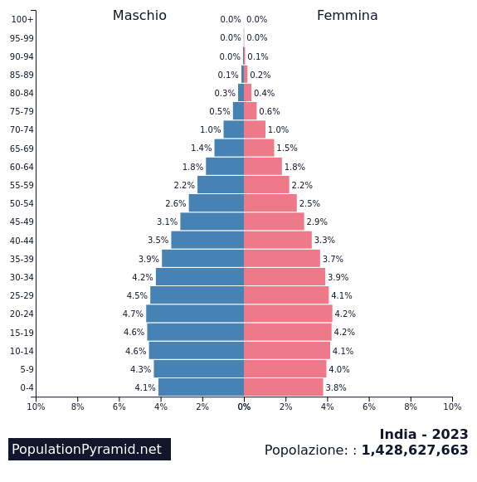
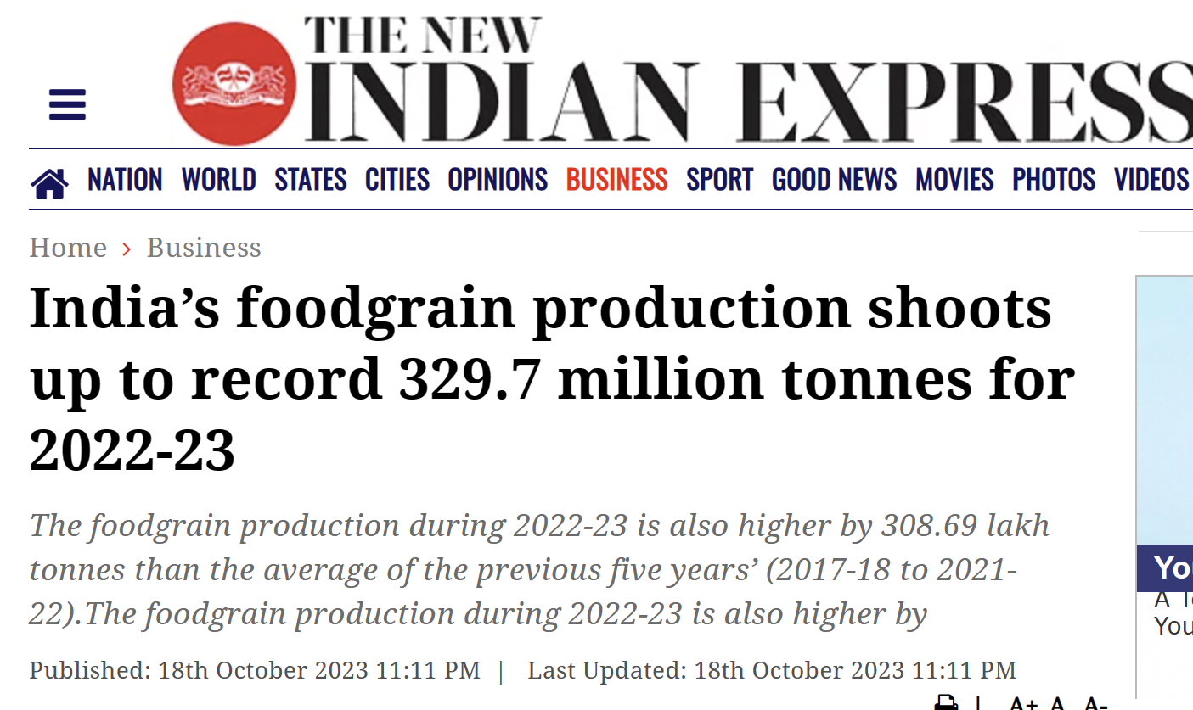
Population growth – Agricultural Production
Parallel race
1950 – 30 Crore 55 MT
2023 – 143 Crore 329.7 MT
(4.73 times) (5.99 times)

Slide 4
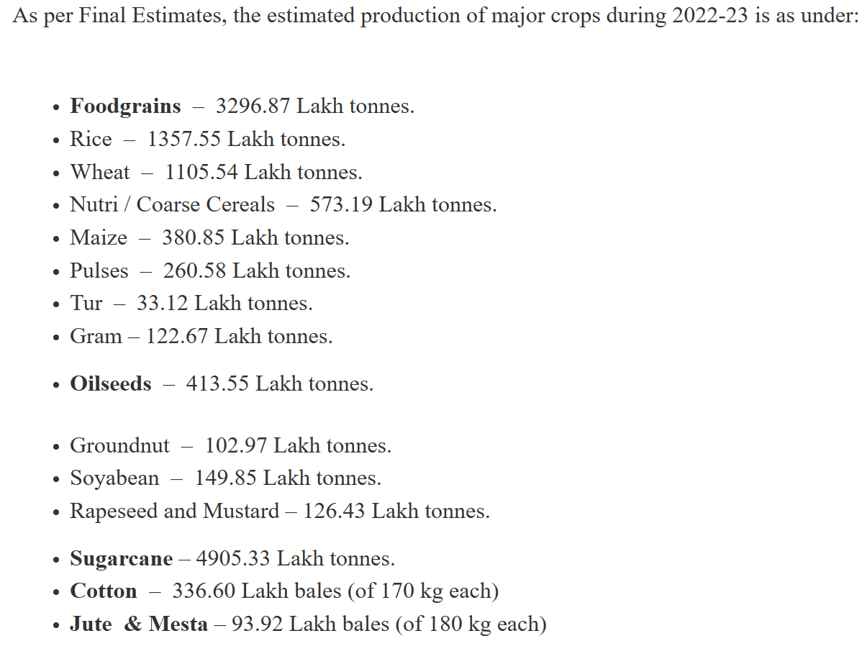

Slide 5
Technology Mediated Technology Transfer System
Technology
Transfer of Technology
Partial Adoption/ Adoption/ Non-Adoption of Technology
Extension Mediated Technology Transfer System
Technology
Society
(Human Element)
Transfer of Technology
Partial Adoption/ Adoption/ Non-Adoption of Technology

Slide 6
Is there relationship between
Nature
Culture
Indian agriculture
ITKs …….
Festivals
Food habits
Medicines

Slide 7
De (1986) stated that a farmer does not become an entrepreneur only by adopting a new agricultural technology but he becomes an entrepreneur only when he comes to be an operator of a farm business.
A business involves rational decisions on investment after assessing risk, other alternatives and possibilities or profit and loss.

Slide 9
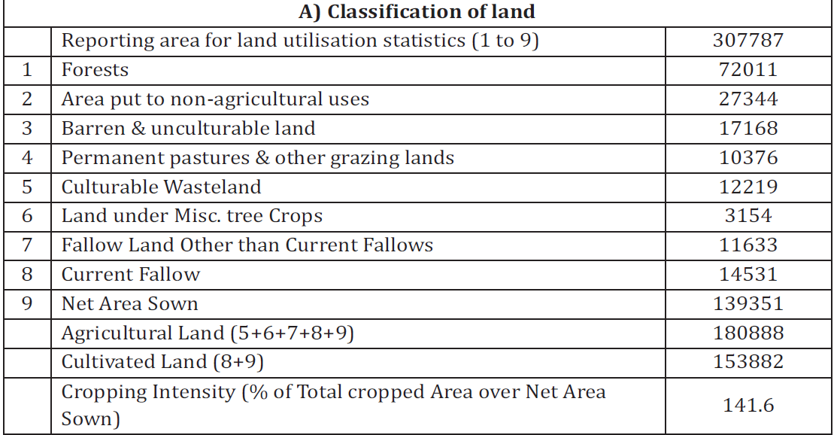

Slide 11
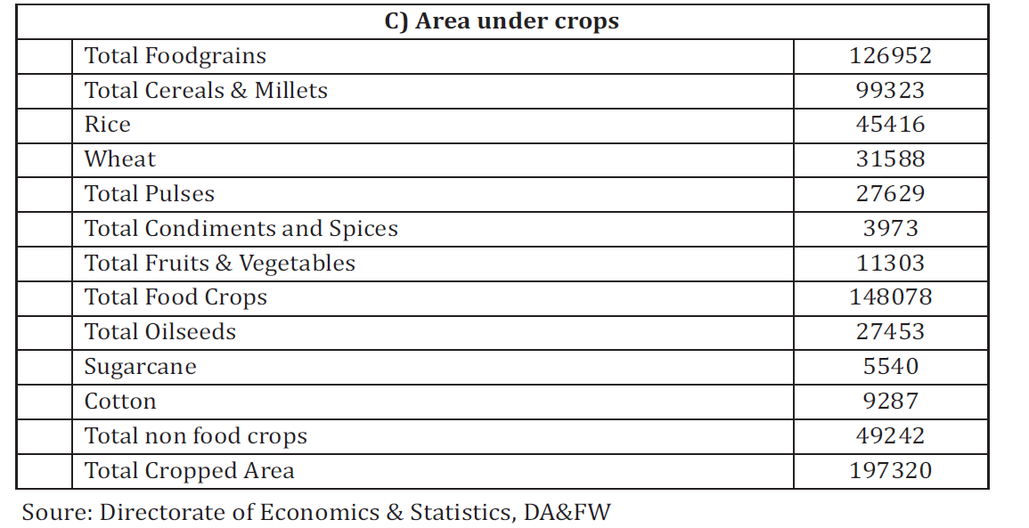

Slide 12
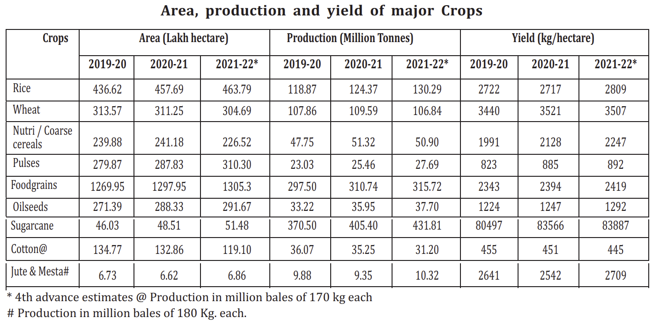

Slide 13
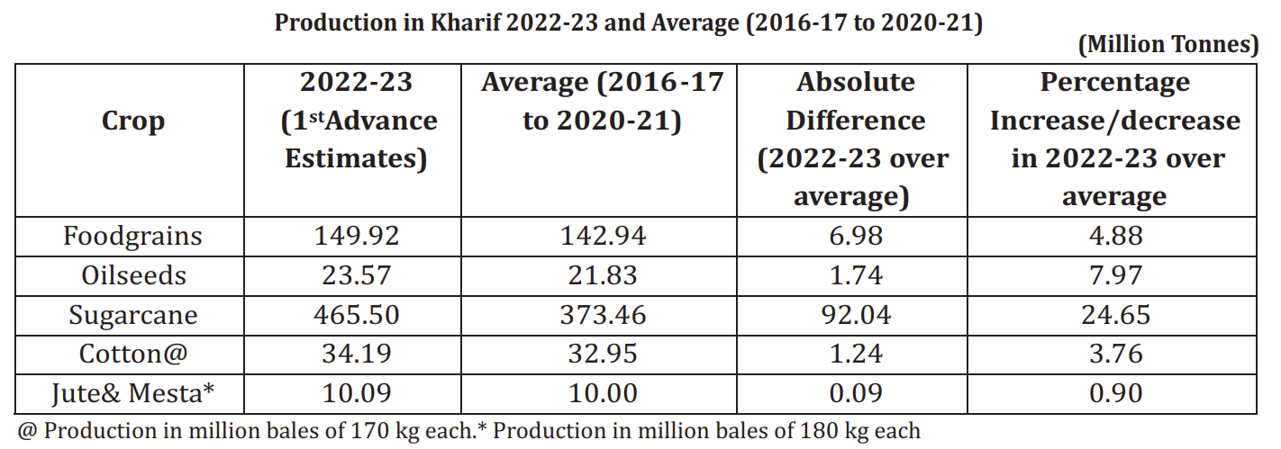

Slide 14
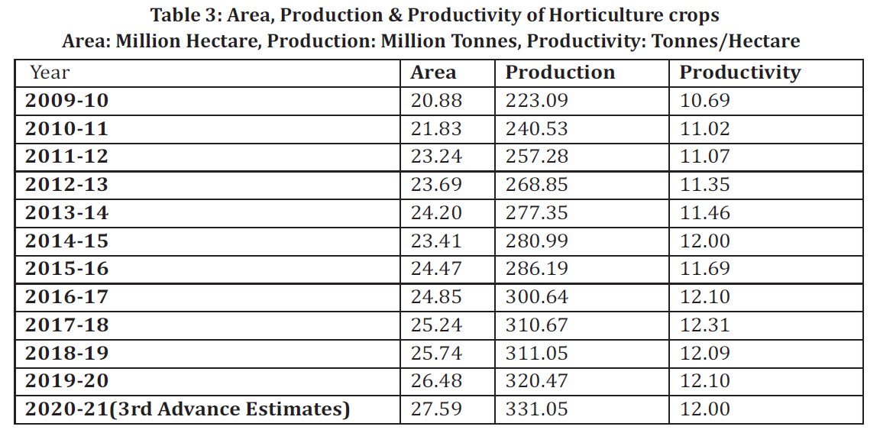

Slide 15
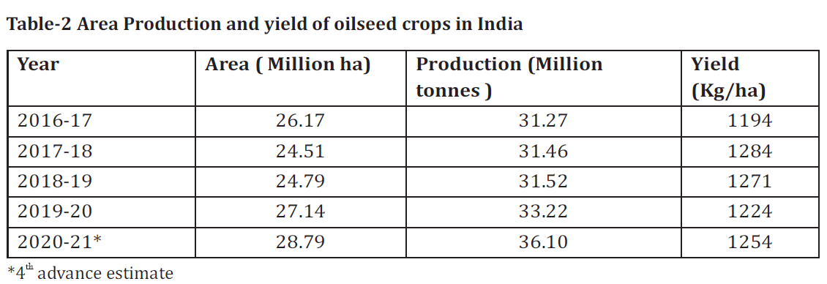

Slide 16
Achievements
Record Production of Food grains
Towards diversification with millets and Horticulture Crops
Growing Importance of Allied Activities
Changing Dynamics of Agriculture Trade
Key Growth Enablers
Productivity Growth
Farm Mechanisation
Growing Irrigation Coverage

Slide 17
Challenges
Climate Change
Agricultural Waste Management
Fragmented Landholdings
Disguised Unemployment
Food Inflation and Volatility in Food Prices
Minimising Post-Harvest Losses
Scaling up Storage Infrastructure
Developing Food Processing Industry
Upgrading Food Quality and Safety Standards
Higher Public Investments

Slide 18
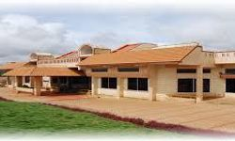
THANK YOU

Slide 19
Conclusion
Parallel race between agriculture and population growth in India
Agriculture in India is part of culture, hence economic dimensions take a back seat
Phenomenal growth, with issues concerning quality, quantity, market, processing, etc

Slide 20
Issues and concerns of Indian Agriculture

Slide 21
Concerns ????
Education
Lack knowledge….. / Awareness about ……..
Information about ……..

Slide 22
Concerns ????
Lack of inputs
Seed
Fertilizer
PPC
Credit
Information

Slide 23
Concerns ????
Lack of machinery
Farm power
Lack of infrastructure

Slide 24
Concerns ????
Market
Storage facilities
Processing facilities

Slide 25
Concerns ????
Agricultural Legislations

Slide 26
Minimum Support Price

Slide 27
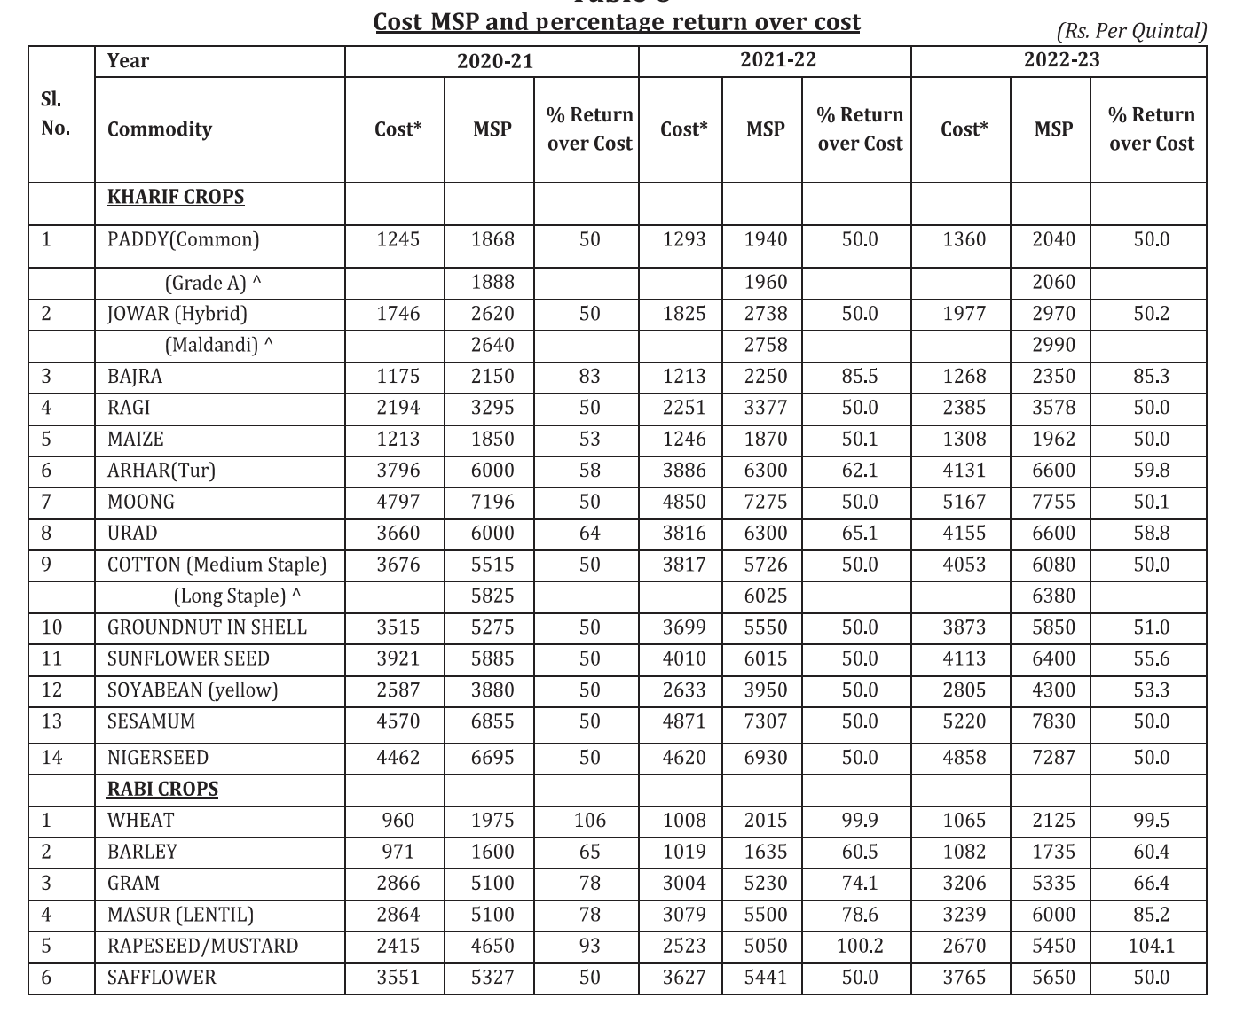

Slide 28
Export – Import

Slide 29
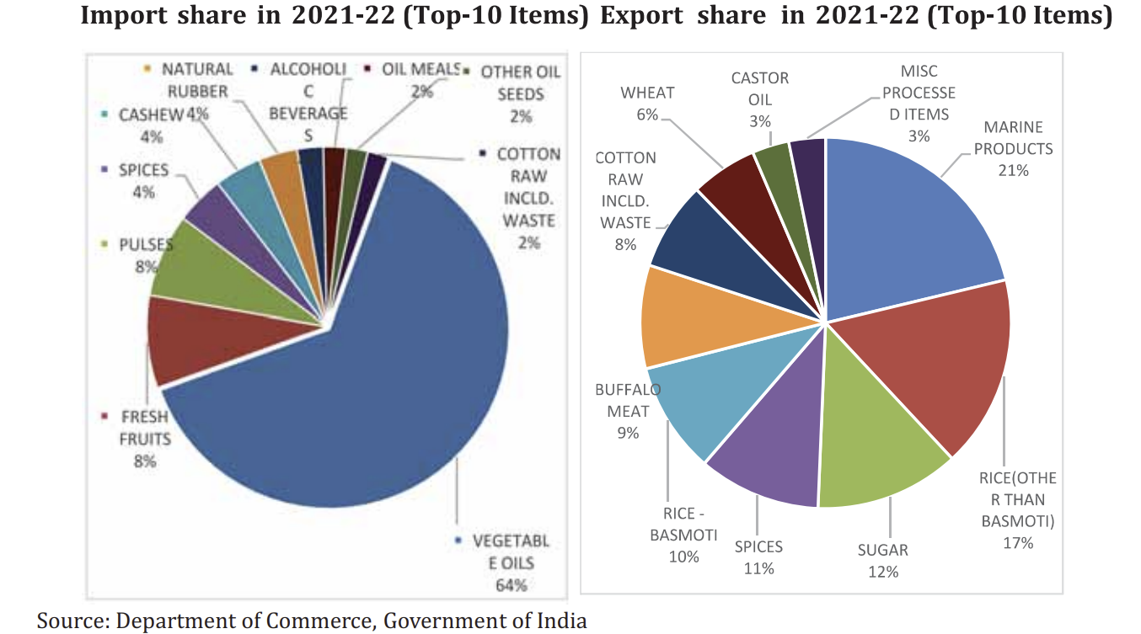

Slide 30
Foreign Direct Investment (FDI) Policy in Agriculture Sector:
Floriculture, Horticulture, Cultivation of Vegetables & Mushrooms under controlled conditions;
Development and Production of seeds and planting material;
Animal Husbandry (including breeding of dogs), Pisciculture, Aquaculture, Apiculture
Services related to agro and allied sectors
Tea sector including tea plantations, Coffee, Rubber, Cardamom, Palm Oil and Olive oil tree plantations through automatic route.

Slide 31
FDI in Multibrand Retail is also permitted up to 51% through Government route in agricultural sector with some conditions.

Slide 32
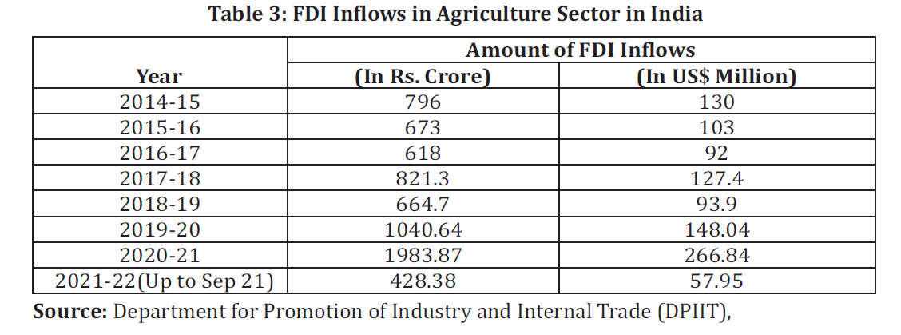

Slide 33
Here is how producer organisations evolved in India (downtoearth.org.in)

Slide 34
Conclusion
Demand-driven information
Participation
Appropriate feedback
Be part of a group
Form a group
Exploit opportunities

Slide 35
THANK YOU

